Slide 1

Graph: Basic Terminology used with Graph
Data Structure | Graph
Course: Data Structure | Chapter: Graph | Bachelor of Engineering
DISCOVER · LEARN · EMPOWER
Notes:
Welcome everyone to today's session on Graphs. We are diving deep into the fundamental language of graph theory. This terminology is the bedrock for understanding complex algorithms like DFS and BFS later in the course. Let us begin by mastering the vocabulary of nodes and edges.

Slide 2
Course Outcomes
SLIDE 2 / 14
Course Outcome
CO | BT LEVEL | DESCRIPTION
CO1 | BT1 | Understand and apply basic data structures, algorithms, complexity analysis, ADTs, arrays and linked lists.
CO2 | BT2 | Apply and implement stacks and queues in problem-solving.
CO3 | BT3 | Analyse and apply searching, sorting, and hashing techniques.
CO4 | BT4 | Construct and apply tree structures and traversal techniques.
CO5 | BT5 | Represent and solve graph problems using DFS, BFS, and graph algorithms.
Chandigarh University
2 / 14
Notes:
Today's lecture directly supports two key course outcomes. First, we apply basic data structure concepts to the abstract graph ADT. Second, we lay the groundwork for solving graph problems using traversal algorithms like DFS and BFS. Mastering these terms is essential for both outcomes.

Slide 3
Learning Objectives
SLIDE 3 / 14
Learning Outcomes
1
Analyze the fundamental components defining a graph structure.
2
Differentiate between directed and undirected graph relationships.
3
Evaluate the significance of vertex degrees in network analysis.
4
Classify various graph types based on edge weights and cycles.
5
Apply terminology to model real-world network connectivity problems.
Chandigarh University
3 / 14
Notes:
By the end of this session, you will be able to analyze graph components critically. You will differentiate between directed and undirected relationships clearly. We will also evaluate vertex degrees and classify graph types. Finally, you will apply these terms to model real-world networks effectively.

Slide 4
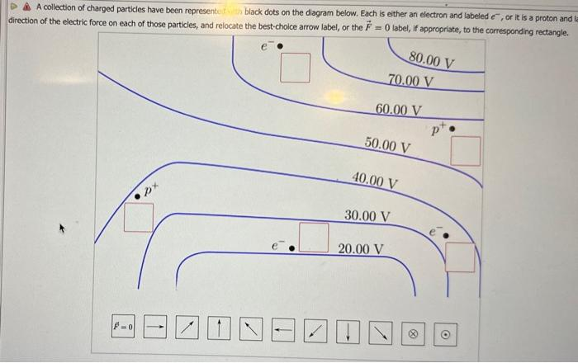
Lecture
SLIDE 4 / 14
Definition of Graph and Vertices
EXAMPLE
A social network where users are vertices in set V.
• A graph G is formally defined as an ordered pair (V, E).
• V represents a finite non-empty set of vertices or nodes.
• E represents a set of edges connecting pairs of vertices.
• Vertices are the fundamental entities representing data points in the graph.
• The cardinality of V determines the total number of nodes present.
Solved A collection of charged particles have been | Chegg.com
Chandigarh University
4 / 14
Notes:
Think of a graph as a mathematical map of connections. The set V contains all the points, like cities on a map. The set E contains the roads connecting these cities. If you have 5 cities, your set V has 5 elements. This formal definition (V, E) is the starting point for all graph algorithms.

Slide 5
Lecture
SLIDE 5 / 14
Edges and Their Representation
EXAMPLE
A one-way street is a directed edge from intersection A to B.
• An edge connects two vertices and represents a relationship or link.
• In undirected graphs, edges are unordered pairs {u, v} of vertices.
• In directed graphs, edges are ordered pairs (u, v) indicating direction.
• Self-loops occur when an edge connects a vertex to itself.
• Parallel edges are multiple edges connecting the same pair of vertices.
Chandigarh University
5 / 14
Notes:
Edges define the relationships between our vertices. In an undirected graph, the connection is mutual, like a two-way street. In a directed graph, the connection has a specific direction, like a one-way street. A self-loop is like a road that starts and ends at the same intersection. Parallel edges mean there are multiple direct routes between two points.

Slide 6
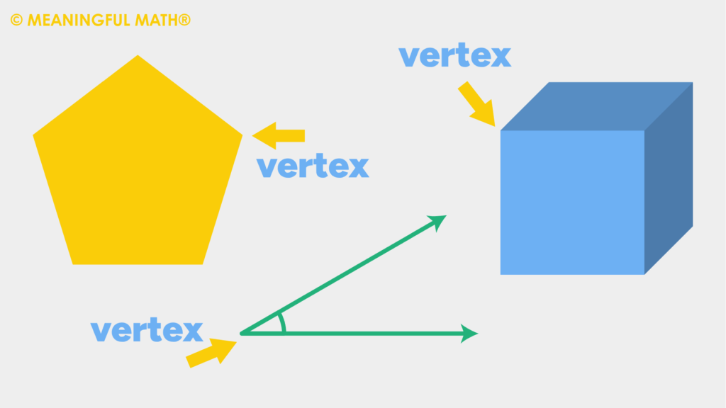
Lecture
SLIDE 6 / 14
Degree of a Vertex
EXAMPLE
A vertex with 3 incoming and 2 outgoing edges has degree 5.
• The degree of a vertex is the count of edges incident to it.
• In directed graphs, we distinguish between in-degree and out-degree.
• In-degree counts edges entering the vertex from other vertices.
• Out-degree counts edges leaving the vertex to other vertices.
• The sum of all degrees in a graph equals twice the number of edges.
Source: www.meaningfulmathco.com
Chandigarh University
6 / 14
Notes:
The degree tells us how connected a specific node is. For directed graphs, we split this into in-degree and out-degree. In-degree counts incoming connections, while out-degree counts outgoing ones. A crucial theorem states that the sum of all degrees equals twice the total number of edges. This helps us verify if a graph drawing is mathematically consistent.

Slide 7
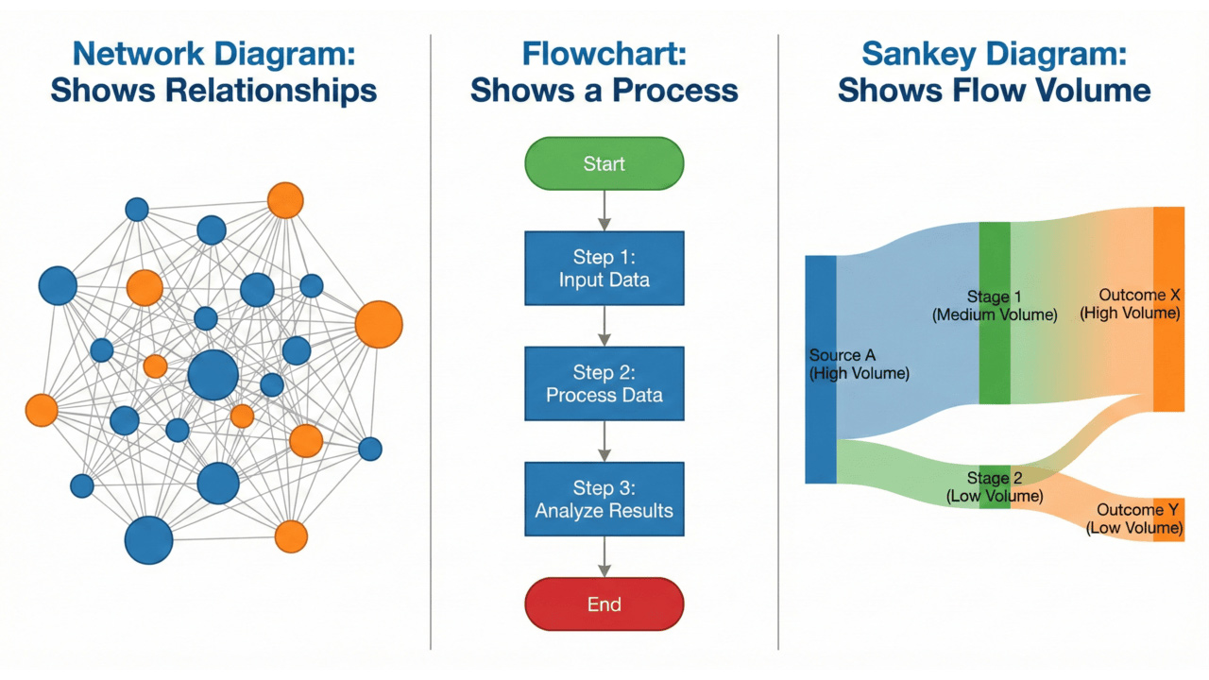
Lecture
SLIDE 7 / 14
Adjacency and Neighbors
EXAMPLE
If A connects to B and C, then B and C are neighbors of A.
• Two vertices are adjacent if they are connected by an edge.
• A neighbor of a vertex is any vertex adjacent to it.
• Adjacency defines the immediate neighborhood of a specific node.
• In directed graphs, u is adjacent to v if an edge (u, v) exists.
• Adjacency lists are a common data structure to store these relationships.
Source: cdn.prod.website-files.com
Chandigarh University
7 / 14
Notes:
Adjacency is the core concept of connectivity. If two nodes share an edge, they are adjacent. The nodes connected to a specific node are its neighbors. In directed graphs, adjacency is directional; if A points to B, B is a neighbor of A, but A might not be a neighbor of B. This concept is vital for traversal algorithms like BFS.

Slide 8
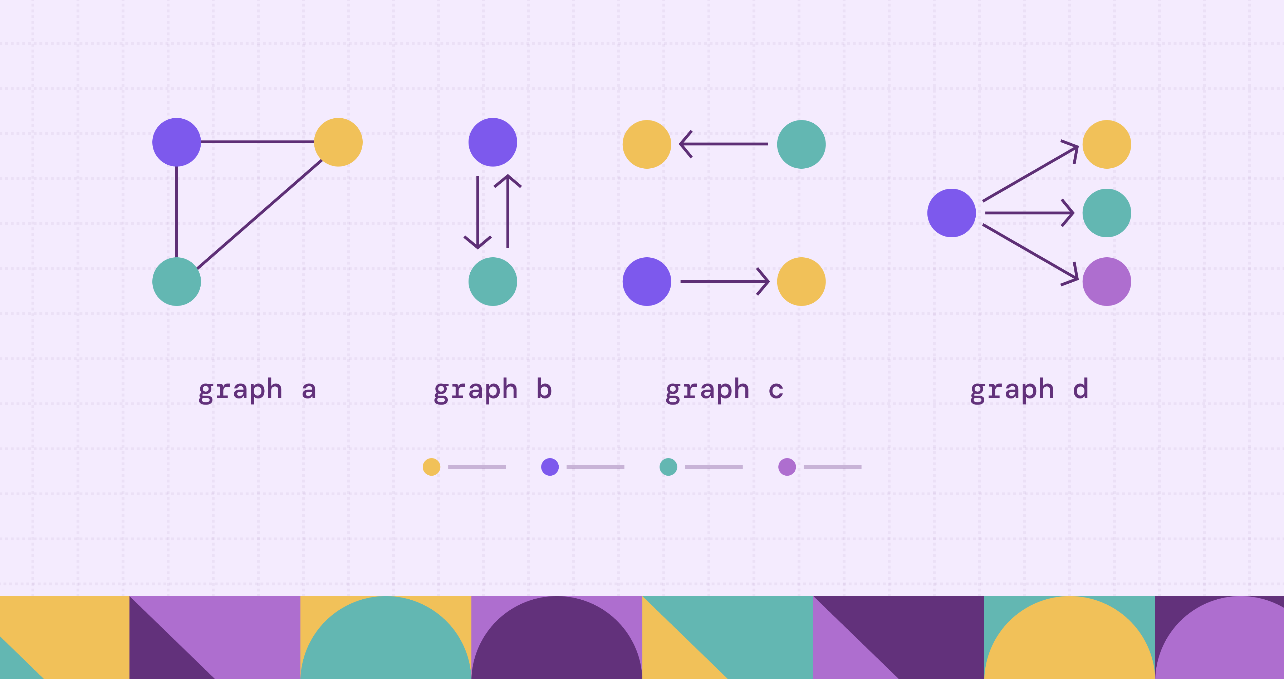
Lecture
SLIDE 8 / 14
Path and Walk Definitions
EXAMPLE
A-B-C-D is a path of length 3 with no repeated nodes.
• A walk is a sequence of vertices and edges starting and ending at vertices.
• A path is a walk with no repeated vertices or edges.
• A trail is a walk with no repeated edges but may repeat vertices.
• The length of a path is the number of edges in the sequence.
• A simple path contains no repeated vertices except possibly the start and end.
Source: cdn.prod.website-files.com
Chandigarh University
8 / 14
Notes:
Let's distinguish between walks, trails, and paths. A walk is any sequence of connected nodes. A trail is a walk where you don't reuse edges. A path is the strictest: no repeated vertices or edges. The length is simply the count of edges. If you visit a node twice, it is not a simple path. This distinction is critical for shortest path algorithms.

Slide 9
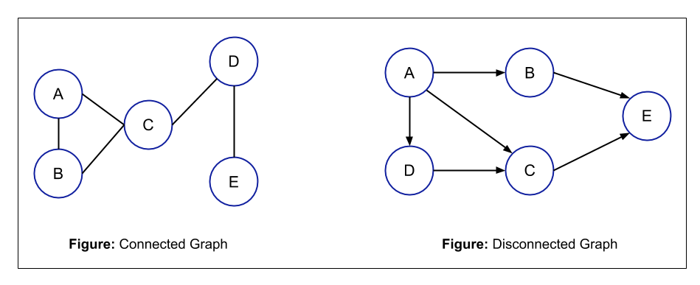
Lecture
SLIDE 9 / 14
Cycles and Connectivity
EXAMPLE
A triangle A-B-C-A forms a simple cycle of length 3.
• A cycle is a path that starts and ends at the same vertex.
• A simple cycle has no repeated vertices except the start and end.
• A graph is connected if a path exists between every pair of vertices.
• A disconnected graph has at least two vertices with no path between them.
• A component is a maximal connected subgraph within a larger graph.
Source: static.afteracademy.com
Chandigarh University
9 / 14
Notes:
Cycles are paths that loop back to the start. A simple cycle has no repeated nodes in between. Connectivity determines if the graph is one single piece. If you can reach any node from any other node, the graph is connected. If not, it is disconnected and consists of multiple components. Understanding components helps in analyzing network reliability.

Slide 10
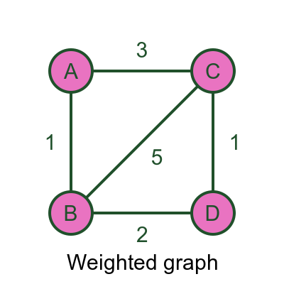
Lecture
SLIDE 10 / 14
Weighted and Unweighted Graphs
EXAMPLE
A road map where edge weights represent distance in kilometers.
• An unweighted graph treats all edges as having equal importance.
• A weighted graph assigns a numerical value or cost to each edge.
• Weights can represent distance, time, cost, or capacity in real systems.
• The cost of a path is the sum of weights of its constituent edges.
• Unweighted graphs are a special case where all edge weights equal one.
Source: graphicmaths.com
Chandigarh University
10 / 14
Notes:
Not all connections are equal. In weighted graphs, edges have values like distance or cost. This changes how we analyze the graph. The cost of a path is the sum of these weights. Unweighted graphs are simpler, treating every connection as a single step. Real-world problems like GPS navigation rely heavily on weighted graphs to find the shortest route.

Slide 11
Lecture
SLIDE 11 / 14
Special Graph Types
EXAMPLE
A complete graph with 4 vertices has 6 edges connecting all pairs.
• A complete graph has an edge between every pair of distinct vertices.
• A tree is a connected graph with no cycles and n-1 edges.
• A bipartite graph divides vertices into two disjoint sets with no internal edges.
• A multigraph allows multiple edges between the same pair of vertices.
• A null graph has vertices but no edges at all.
Chandigarh University
11 / 14
Notes:
There are special types of graphs with unique properties. A complete graph connects every node to every other node. A tree is a special connected graph with no cycles, essential for hierarchical data. Bipartite graphs split nodes into two groups, useful for matching problems. Multigraphs allow multiple edges, while null graphs have no connections. Recognizing these types simplifies algorithm selection.

Slide 12
Worked Example
SLIDE 12 / 14
Degree Calculation
GOVERNING EQUATION
Sum of degrees = 2 + 2 + 3 + 1 = 8, which equals 2 × 4 edges
1
Consider a graph with vertices {A, B, C, D} and edges {(A,B), (A,C), (B,C), (C,D)}.
2
Vertex A has edges to B and C, so its degree is 2.
3
Vertex B has edges to A and C, so its degree is 2.
4
Vertex C has edges to A, B, and D, so its degree is 3.
5
Vertex D has an edge to C, so its degree is 1.
Chandigarh University
12 / 14
Notes:
Let's calculate degrees for a specific example. Vertex A connects to B and C, giving it a degree of 2. Vertex B also connects to A and C, so its degree is 2. Vertex C is the hub, connecting to A, B, and D, making its degree 3. Vertex D only connects to C, so its degree is 1. The sum is 8, which is exactly twice the number of edges (4). This confirms the Handshaking Lemma.

Slide 13
Lecture
SLIDE 13 / 14
Key Takeaways
1
Graphs are defined by vertices V and edges E forming relationships.
2
Directed edges have direction, while undirected edges are bidirectional.
3
Degree measures connectivity, with sum of degrees equaling twice the edges.
4
Paths have no repeated vertices, while cycles return to the start.
5
Weights add cost to edges, crucial for optimization and shortest path problems.
Chandigarh University
13 / 14
Notes:
To summarize, graphs are defined by vertices and edges. We must distinguish between directed and undirected relationships. The degree of a node is a key metric for connectivity. Paths and cycles define how we traverse the graph. Finally, weights allow us to model real-world costs and optimize our solutions.

Slide 14
Lecture
SLIDE 14 / 14
References
DATA STRUCTURES
A Pseudocode Approach with C — Gilberg, Forouzan
• Data Structures — Lipschutz
• Data Structure Using C — AK Sharma
• C and Data structure — P. S. Deshpandey
Chandigarh University
14 / 14
Notes:
These four textbooks provide comprehensive coverage of graph theory and implementation. Gilberg and Forouzan offer excellent pseudocode approaches. Lipschutz provides a strong theoretical foundation. Sharma and Deshpandey focus on C implementation details. Please refer to these texts for deeper study and practice problems.

